Slide 1


Slide 2
Team Members
Ambati Haari Krishna Reddy
Aravind Sarangadharan
Abhishek Banerjee
Pavan Kumar
Ruby Wilson
Vaishali Dewangan
Kajol Chakraborty

Slide 3
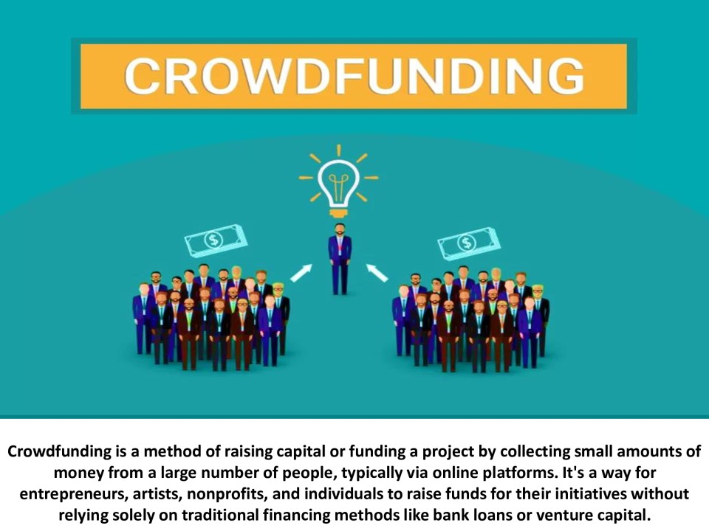

Slide 4
Introduction of kickstarter
Many creative individuals struggle to secure traditional funding for innovative projects due to high barriers and limited access to investors. Kickstarter addresses this gap by providing a crowdfunding platform that connects creators directly with backers, enabling them to raise funds, validate ideas, and bring projects to life without relying on conventional financing methods.

Slide 5
Key Performance Indicators (KPIs):
1. Funding Success Rate
Formula: (Successful Projects / Total Projects) × 100
Insight: Measures how effectively creators meet their funding goals. A low rate may suggest poor project presentation or low backer confidence.
2. Average Pledge Amount
Formula: Total Pledged Amount / Number of Backers
Insight: Helps understand how much each backer contributes on average. A rising value may indicate growing trust or interest in projects.
3. Total Funds Raised
Formula: Sum of all successfully funded project amounts
Insight: Tracks platform growth and overall user engagement.
4. Number of Active Backers
Insight: Indicates community size and user retention. A growing backer base suggests positive platform reputation and performance.
5. Project Launch Frequency
Formula: Number of Projects Launched per Month/Quarter
Insight: Reflects creator interest and platform activity levels.
6. Campaign Engagement Rate
Includes: Likes, Shares, Comments, Video Views
Insight: High engagement usually correlates with higher conversion and funding rates.
7. Repeat Backer Rate
Formula: (Returning Backers / Total Backers) × 100
Insight: A high rate suggests platform loyalty and successful user experience.
8. Time to Reach Funding Goal
Insight: Projects that hit goals quickly often have compelling ideas or strong marketing; can be used to identify best practices.
9. Conversion Rate
Formula: (Backers / Visitors) × 100
Insight: Evaluates how effectively campaign pages convert visitors into funders.

Slide 6
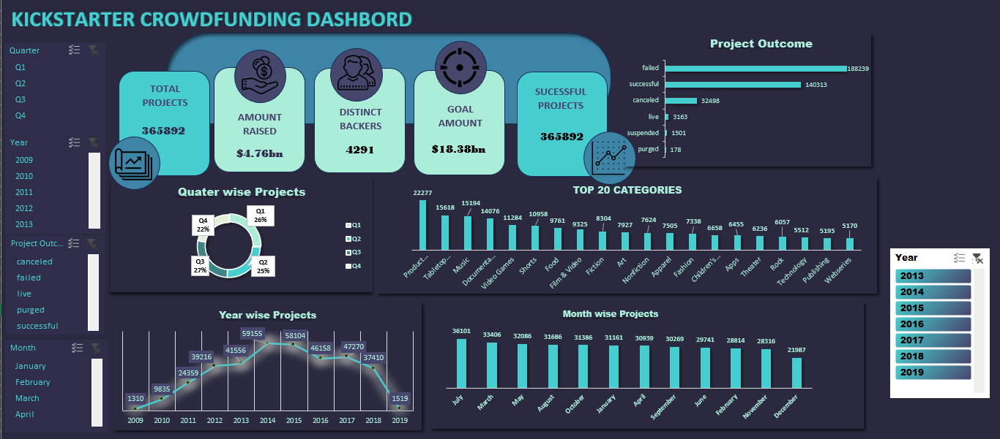
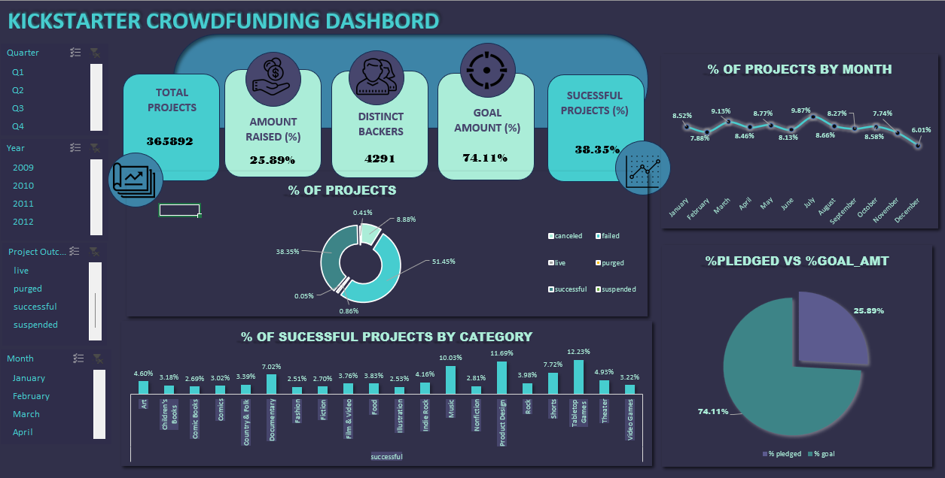
EXCEL DASHBORADS:

Slide 7
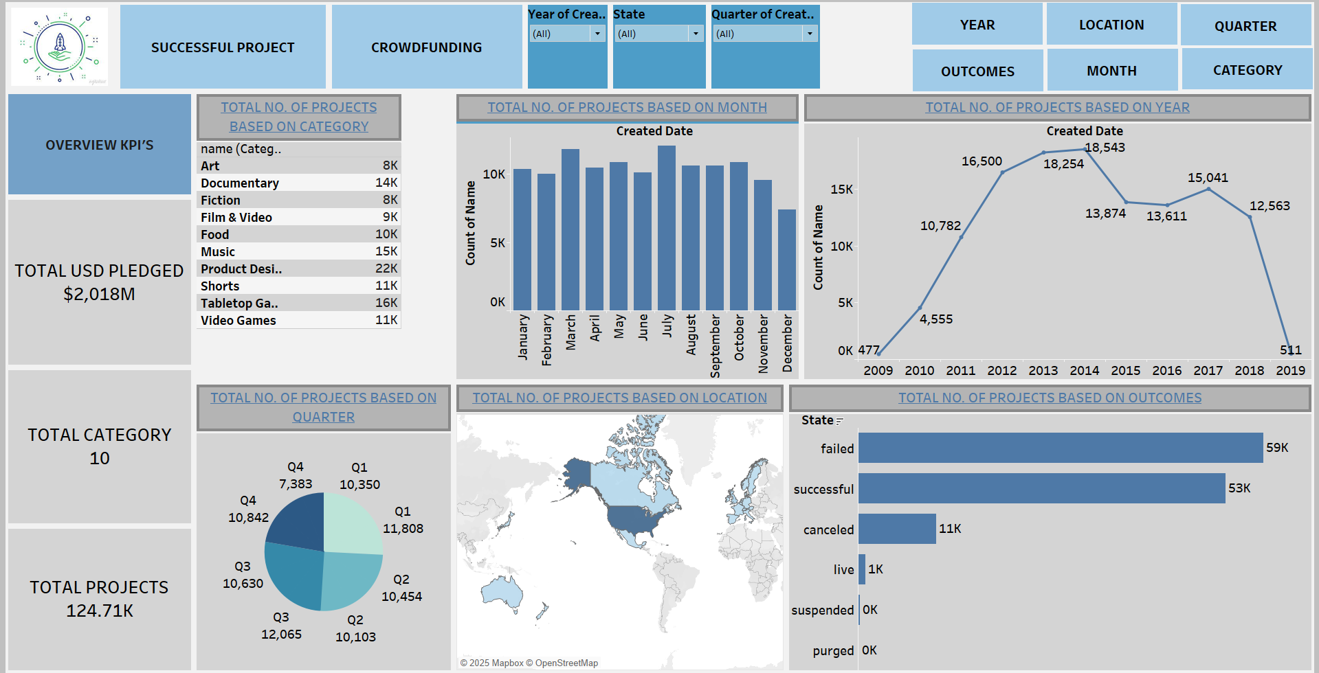
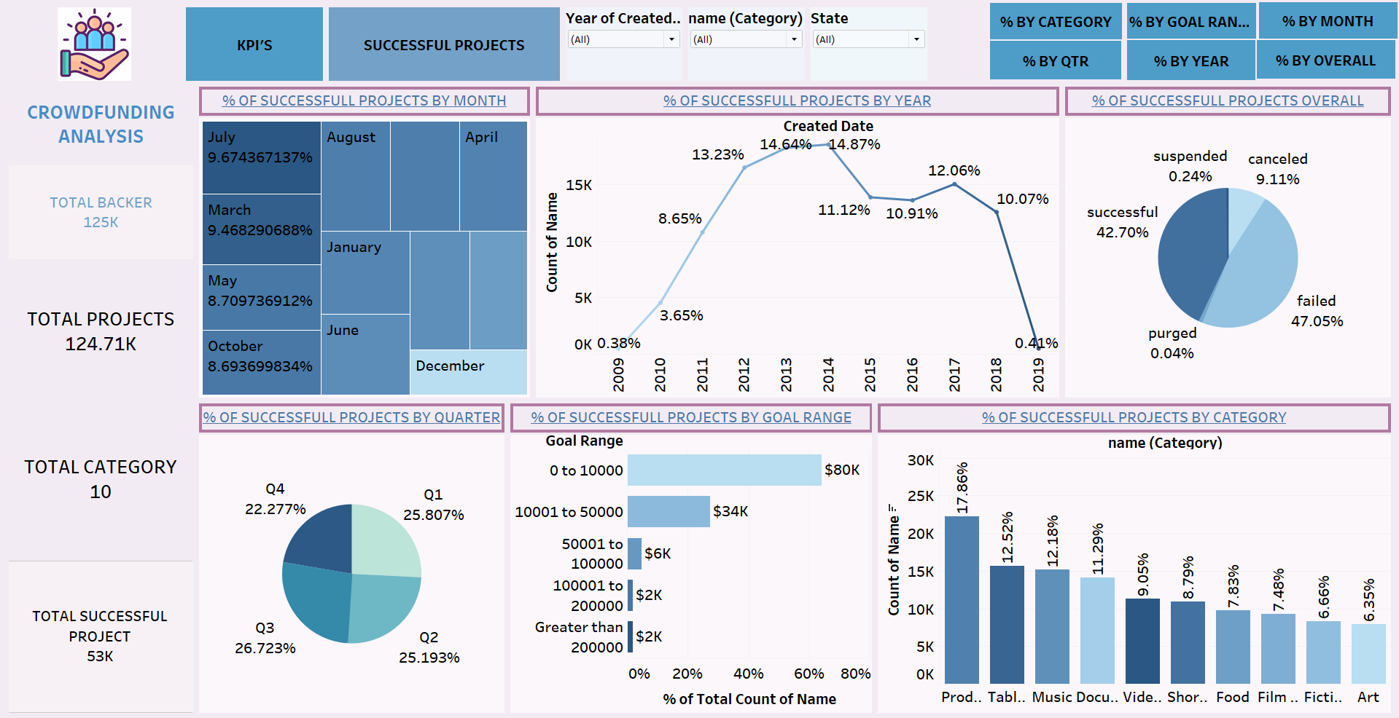
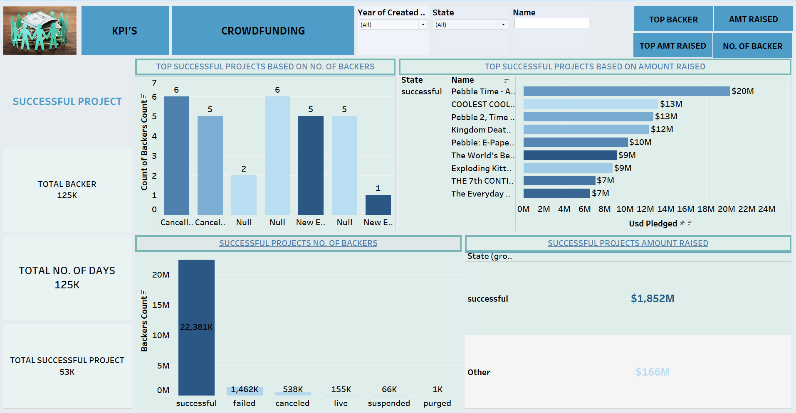
TABLEAU DASHBORDS

Slide 8
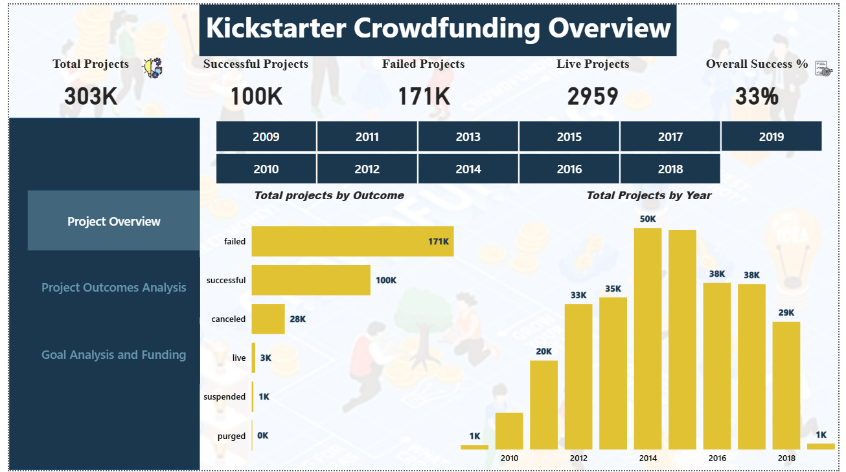
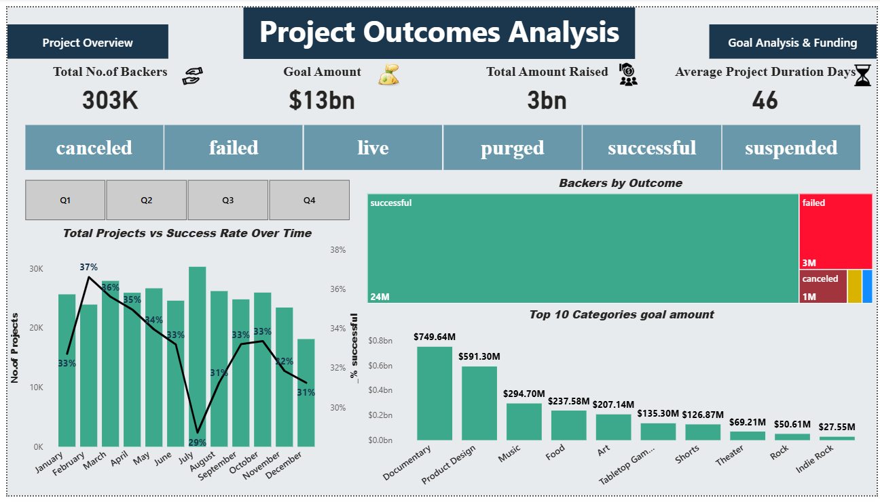
POWER BI DASHBOARDS:

Slide 9
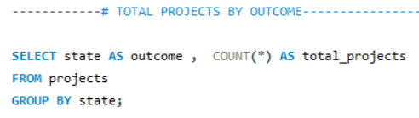
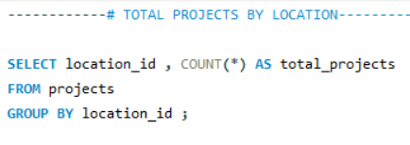
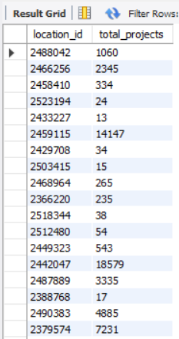
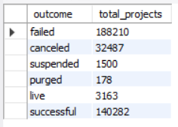
SQL QUERIES OUTPUTS:

Slide 10
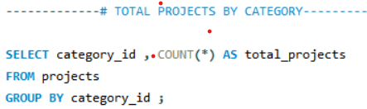
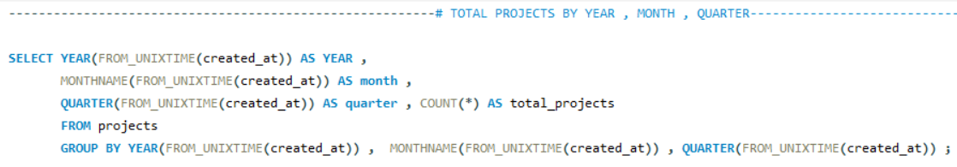
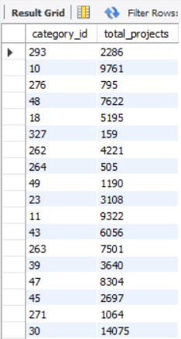

SQL QUESRIES OUTPUTS CONT.:

Slide 11
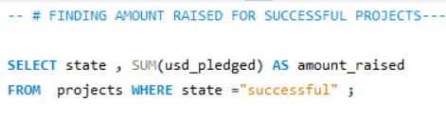
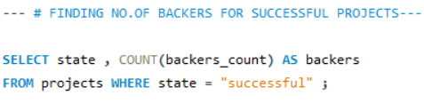


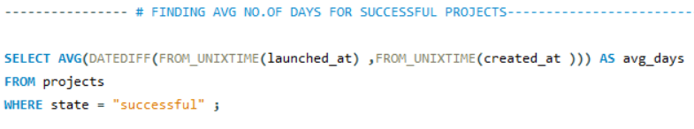

SQL QUESRIES OUTPUTS CONT.:

Slide 12
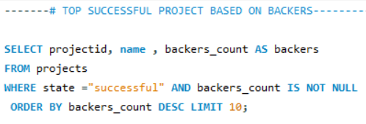
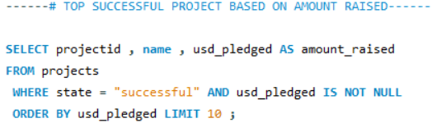
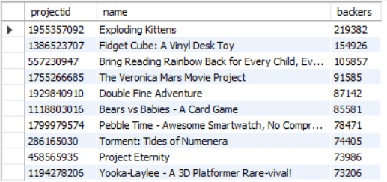
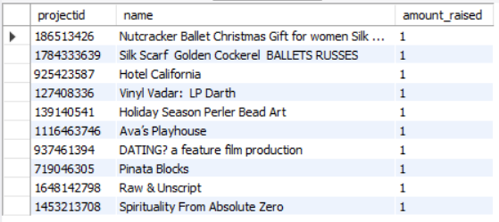
SQL QUERIES OUTPUTS CONT.:

Slide 13
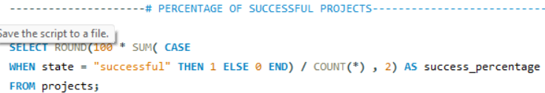
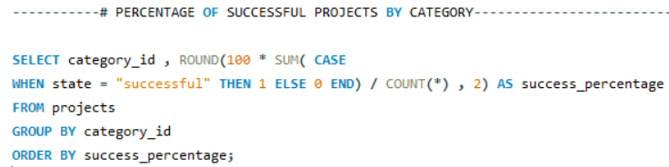
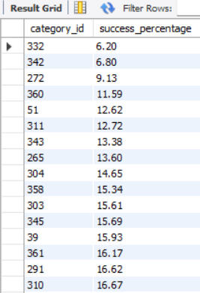
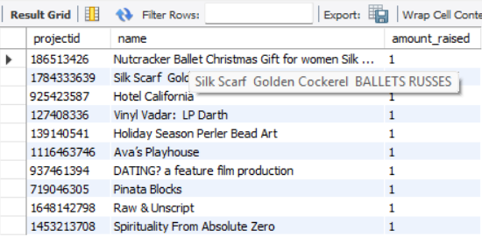
SQL QUERIES OUTPUTS CONT.:

Slide 14
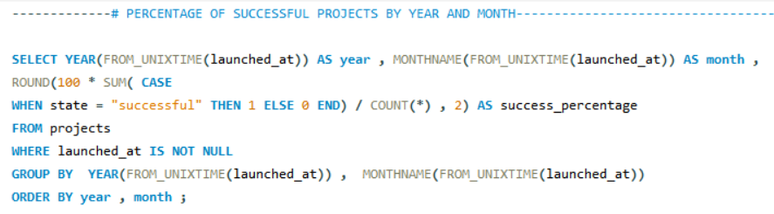
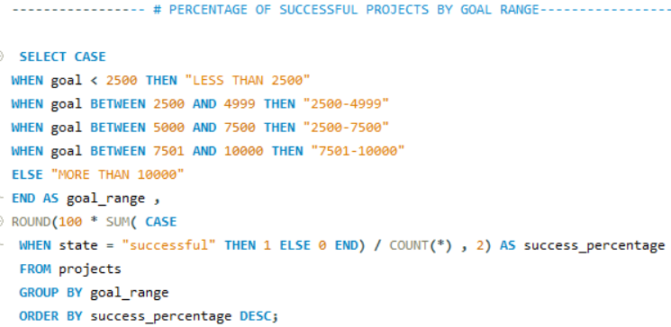
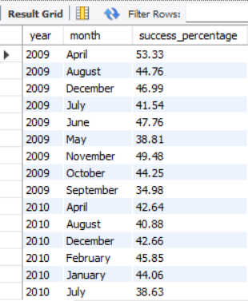
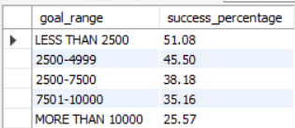
SQL QUESRIES OUTPUTS CONT.:

Slide 15
Project Summary:
This project conducted a comprehensive analysis of Kickstarter as a crowdfunding platform, with a focus on its functionality, performance, and value in enabling creators to realize their ideas through community-based funding. By evaluating key performance indicators such as Funding Success Rate, Average Pledge Amount, and Backer Engagement, the study provided meaningful insights into the factors that contribute to campaign success. These findings underscore the importance of strategic campaign design, audience engagement, and platform trust in driving positive outcomes for both creators and backers.

Slide 16
Key Learnings:
A strong Funding Success Rate is often linked to compelling storytelling, clear rewards, and early momentum.
Engaged backers are essential—not just for funding but for promoting and validating project ideas.
Repeat backers and short time-to-goal metrics indicate trust in the platform and high campaign quality.
Consistent project launches reflect a healthy ecosystem that supports both creators and funders.

Slide 17
Thank You From Group 01

